Slide 1
Azure SQL – Cloud me
George Walkey
DBA
Patient First
Richmond, VA

Slide 2
Agenda
1) Migrate On-Premises DB to Azure SQL
2) Backup to URL
3) Stretch Database

Slide 3
Migrate On-Premises DB to Azure SQL
Upsizing Method 1
1) SSMS
a) Creates a local Bacpac
b) Copies Bacpac to your Azure account
c) Creates the Azure SQL Db from that Bacpac
d) Wizard allows you to chose Size/Edition/GB

Slide 4
Migrate On-Premises DB to Azure SQL
Upsizing Method 2
1) SQLPackage.exe
sqlpackage.exe
/Action:Export
/ssn:localhost
/sdn:AdventureWorks2014
/tf:C:\bacpacs\AW2014.bacpac
/p:TableData=dbo.table

Slide 5
Migrate On-Premises DB to Azure SQL
Upsizing Method 2
1) SQLPackage.exe
a) Creates a local Bacpac
b) Use SSMS, SSDT or Azure Portal to publish
Export from local:
C:\Program Files (x86)\Microsoft SQL Server\130\DAC\bin\sqlpackage.exe” /a:Export /ssn:localhost /sdn:AdventureWorks2014 /tf:C:\Bacpacs\AW2014.Bacpac
Import/Publish to Azure:
C:\Program Files (x86)\Microsoft SQL Server\130\DAC\bin\sqlpackage.exe” /a:Import /sf:C:\Bacpacs\AW2014.bacpac /tsn:yourdbserver01.database.windows.net /tdn:AdventureWorks2014 /tu:myadmin@yourdbserver01 /tp:Pa55w0rd

Slide 6
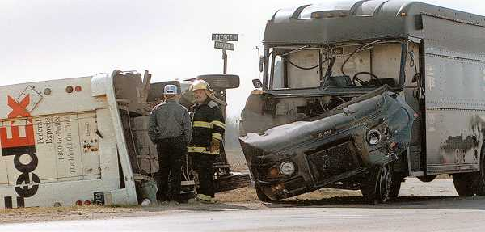
Migrate On-Premises DB to Azure SQL
Upsizing Method 3
1) DACFx

Slide 7
Migrate On-Premises DB to Azure SQL
Upsizing Method 4
1) SSDT
a) Create SQL Database Project from a local DB
b) Set Project Build Properties and Choose Edition
c) Publish to Azure from Project right-click
d) Check project into TFS/Git
e) SSDT becomes your DB Mgmt/C.I. Tool
f) All Devs/DBAs should use SSDT/VS – or else

Slide 8
BacKup to URL
1) TSQL-Schedule as Agent Job
a) Azure is just another file destination
b) Becomes part of the backup chain
c) Create SQL Credential from Storage Acct/Key
d) Do NOT interrupt the upload

Slide 9
BacKup to URL - TSQL
BACKUP DATABASE AdventureWorks2014 TO URL = 'https://edwardsnowden01.blob.core.windows.net/backup102/HillarysEmails.bak'
WITH CREDENTIAL = 'AzureSQLStore'
,COMPRESSION
,FORMAT
,INIT
,STATS = 1

Slide 10
BacKup to URL - Powershell
Backup-SqlDatabase
-ServerInstance "localhost"
-Database "AdventureWorks2014"
-BackupFile “AdventureWorks2014.bak”
-SqlCredential “AzureSQLStore “
-CompressionOption On
-BackupContainer "https://edwardsnowden01.blob.core.windows.net/backup102/"
-BackupAction Database
-CopyOnly
-MediaDescription "Daily Backup (Get-Date).ToString('yyyy-MM-dd')"
-Checksum

Slide 11
Stretch Database
Use CTP 3.2 Sample Code
Adventureworks2016CTP3
SSMS GUI to Enable and Monitor
4 New DMVs to Monitor
No Powershell cmdlets - yet
Creates a new S3 Standard 250GB Database
Script-out shows new DB and Table properties

Slide 12
github.com/gwalkey george@insyncva.com

